Slide 1
Brielle PTO Meeting
October 6, 2021

Slide 2
President Report:
A special thank you to the previous years PTO Board Members: Co-Presidents Nancy Atnes & Kendal Porter; Vice President Erica Paone; Secretary Traci Moretti and Treasurer Meghan Herbert
Thank you to all the families that signed up to become PTO members! We have 218 parents/teachers that have signed up!
Gold Members:
Thank you to the committee chairs and volunteers for giving the PTO their time and effort to manage and execute successful events!
Thank you to the teachers and staff for all of the support as we navigate the school year as a new PTO board!

Slide 3
Gold PTO Members:
Melissa Arnott | Lauren Harms-Kreig | Megan Maltz | May Petracco | Eva Zelinsky
Nancy Atnes | Tracy Heald | Janine Martin | Loren Raab
Erin Augustine | Tara Healey | Courtney Matthaei | Drew Sisk
Courtney Baiardi | Laura Heller | Stacy McDaid | Melissa Sosa-Longo
Stacey Cali | Katie Hickey | Sheila Gonzalez Mellody | Tim Stokes
Nicole D’Ambrosio | Lisa Huch | Liz Mills | Kathleen Trombly
Anne Eichner | Jennifer Introna | Traci Moretti | Christin Walsh
Alison Ertl | Jill Jacoski | Kara Murphy | Mary Walsh
Kelli Fahey | Megan Kohl | Joseph Niemczyk | Michelle Whiting
Lori Giunco | Ellen Lafferty | Nikki Pandozzi | Jennifer Wohltman

Slide 4
Vice President Report:
Spiritwear Sales
Sale ran from August 16 – August 28
The PTO profited $1,054.50.
Next sale is the Holiday Spiritwear sale, and we are running it early due to shortages.
Suggestions on Spiritwear items to be offered.

Slide 5
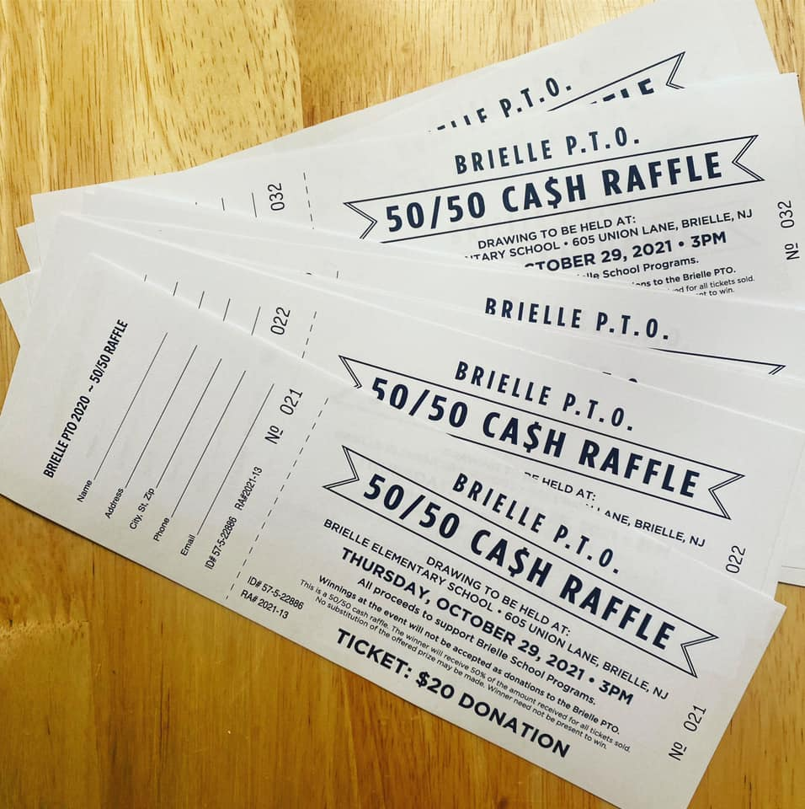
Vice President Report:
50/50 Raffle Tickets
On sale now through October 25. Drawing to be held Friday, October 29th after school.
This is one of our biggest fundraisers that generates funds for the PTO and our programs. We want to sell as much as possible.
Please return ticket stubs to PTO mailbox in main office or contact Kayte at kaitlin.keller1@gmail.com to arrange dropoff.
Class parents have received 5 tickets each to sell.
More tickets are available.
We are now accepting Venmo payments!

Slide 6
Treasurer Report:
Operating Budget 2021-2022
Account Balances: Main, Class 2022, Class 2023 & Class 2024

Slide 7
Principal Report

Slide 8
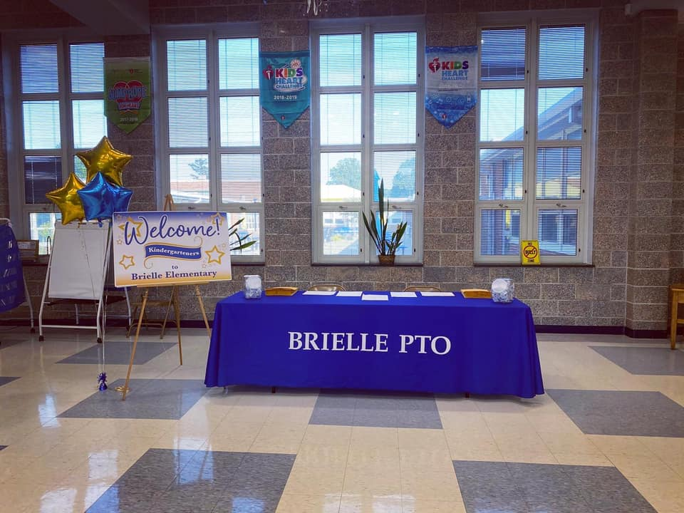
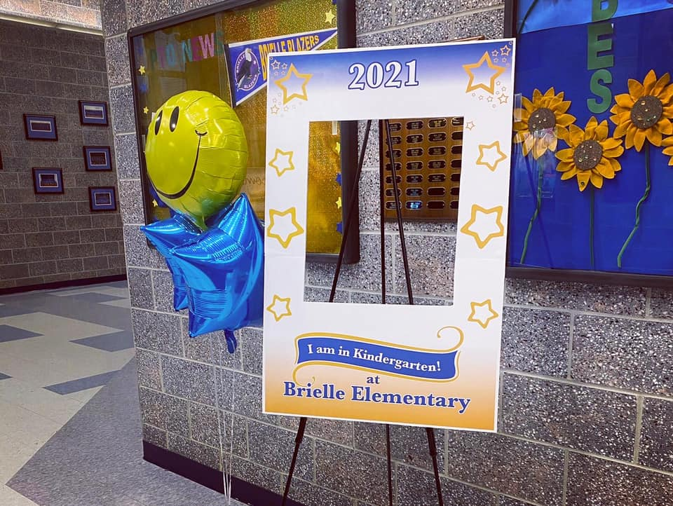
Kindergarten and New Student Orientation:
Committee Chair - Courtney Gilmartin
Held on August 26th
School Store Opened
Welcomed 45 kindergarteners and
18 new students

Slide 9
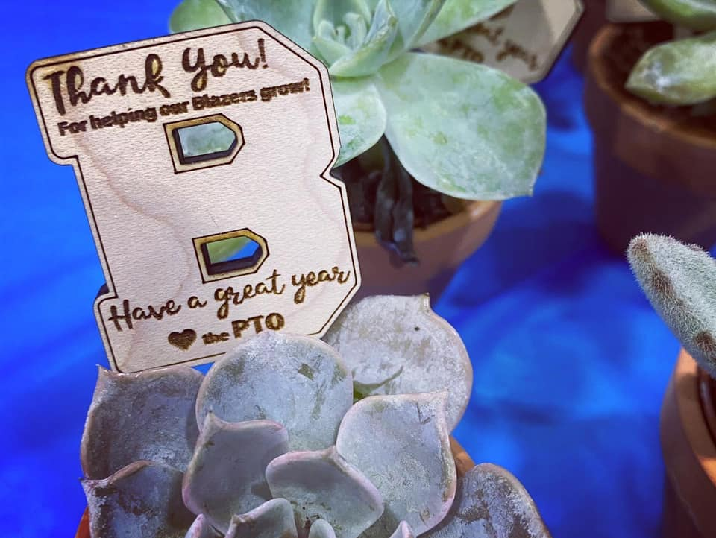
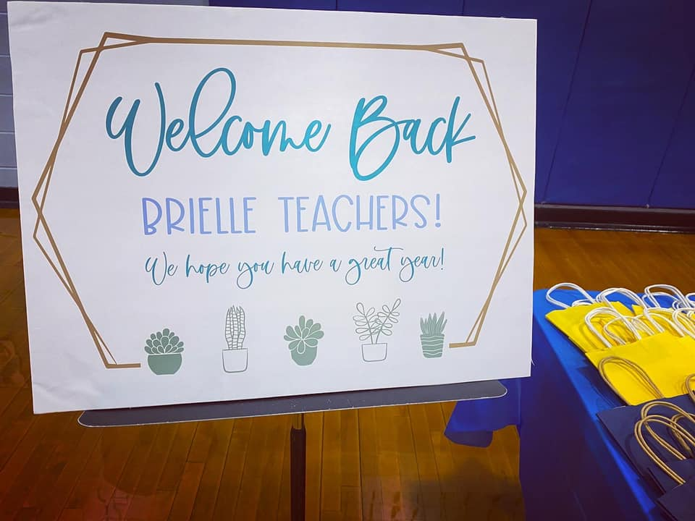
Welcome Back Breakfast:
Committee Chair - Kathleen Bade
Held on September 1
Provided breakfast to approximately 80 staff members
PTO provided small succulent plants to all staff
Thank you to everyone who donated goods!

Slide 10
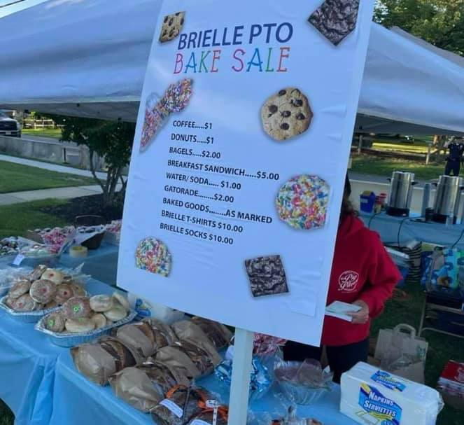
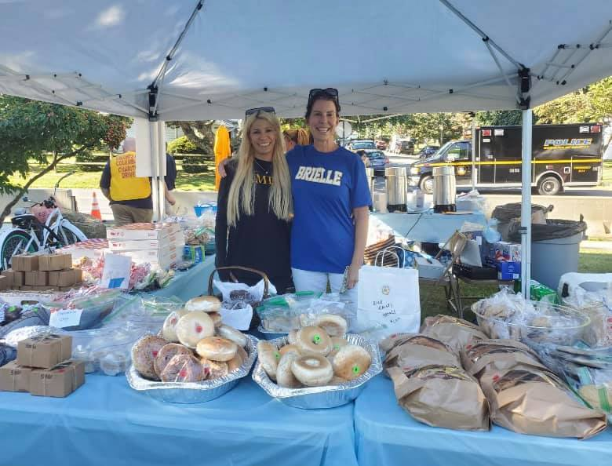
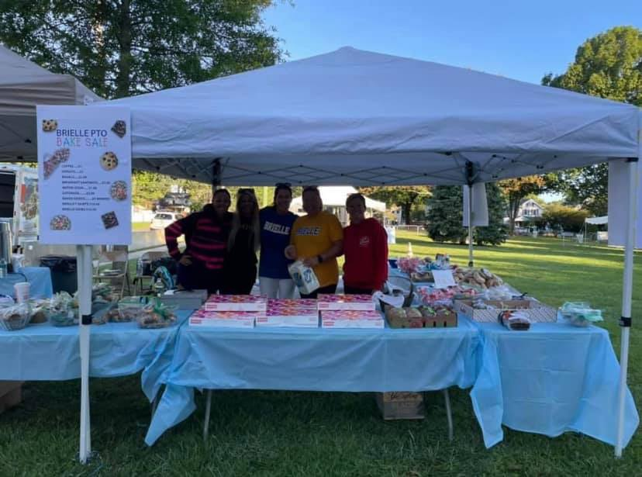
8th Grade Brielle Day Bake Sale
Committee Chairs - Steph Frith, Michelle Bellusci, Amanda O’Neil, Tracy Heald and Lilly Smith
Held on September 11th
Had an overwhelming amount of donations
Raised over $2300 for the class
Thank you to everyone who donated baked goods!

Slide 11
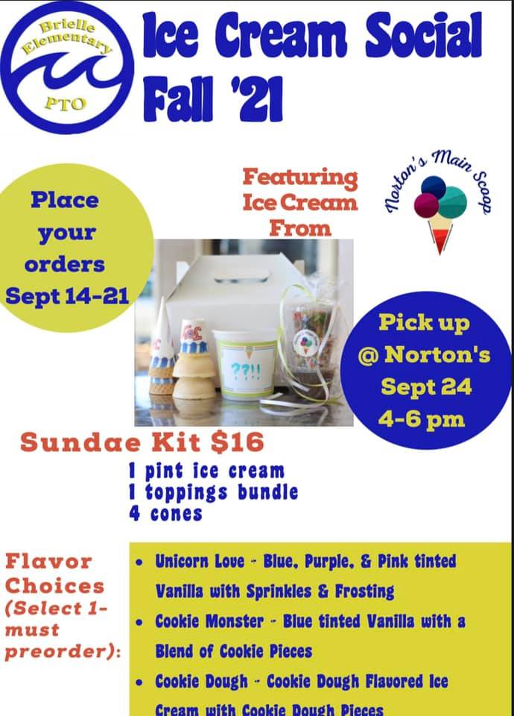
6th Grade Ice Cream Social
Committee Chairs - Kathy Olson, Lori Giunco
Ice Cream Pick Up – September 24th
A total of 42 kits ordered
Raised $252 for the 6th grade class

Slide 12
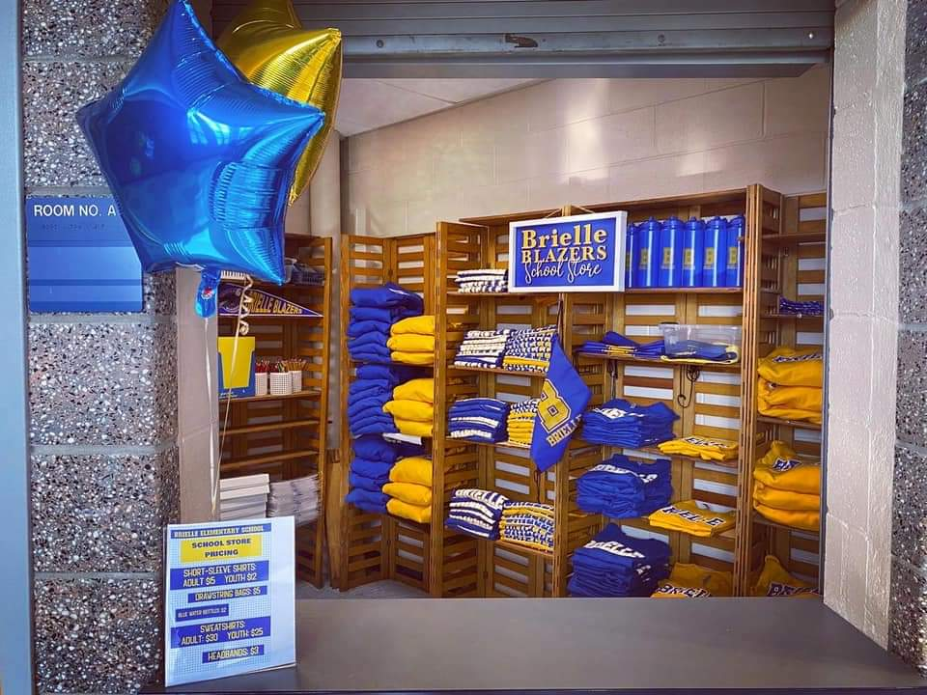
School Store
Committee Chair - Tricia Callahan
School store is expected to be open during the year.
All students are welcome, even if they exit another door, come to the main lobby after pick up.
Select Spiritwear items sold
Snacks and drinks also offered

Slide 13
Class Parents
Please contact your fellow class parent.
Please get your class list from your child's teacher with email addresses for email blasts.
After you receive your class list, please send out an email blast to encourage every family to become a member of the PTO. Memberships can be purchased via the link on the PTO Membership tab on the PTO website: www.brielleelementary.my-PTO.org
Inform all of your class families about our 50/50 Raffle Fundraiser! This is one of our biggest fundraisers of the year, and our goal is to sell out of tickets once again this year. Class families can purchase tickets directly through you. If you need more tickets, please contact Kayte Keller at kaitlin.keller1@gmail.com.
There are to be no in-class parties or food items sent in to the school at this time. Do your best to be creative with other, non-food items!

Slide 14
New Business - Upcoming Events
PTO 50/50 | Kaitlin Keller |  |  | October 29, 2021
Giving Tree | Stacy McDaid |  |  | December 1, 2021
Book Fair - Winter | Tara Healey | Kelly Hadell |  | November 30, 2021 | December 4, 2021
7th Grade Pancake Breakfast | Mishelle Whiting | Traci Moretti | Nancy Atnes | December 4, 2021
Restaurant Night - Chipotle | Kaitlin Keller |  |  | Need to confirm date - may be Winter or Spring
Enrichment - Winter | Beth Catania | Terri DeMarco |  | January 4, 2022 | February 10, 2022

Slide 15
New Business
Webmaster to help the PTO find a new platform and to help develop a new website.
Does anyone have contacts we could reach out to?
Maybe a high schooler that is looking for volunteer hours and is tech savvy?
Pizza Fridays
Need 3 volunteers for each lunch shift
Orders would be placed through Jimmy’s and then pizzas would be delivered to the school
Volunteer requirements
2 or less visits to the school a week are not considered regular basis.

Slide 16
Next Meetings
February 23, 2022 - 7:00 pm
May 18, 2022 - 7:00 pm

